Slide 1
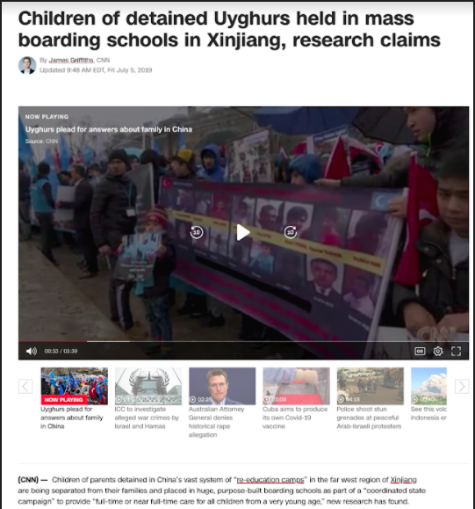
Children of detained Uyghurs held in mass boarding schools in Xinjiang, research claims
https://www.cnn.com/2019/07/05/asia/xinjiang-muslims-china-intl-hnk/index.html

Slide 2
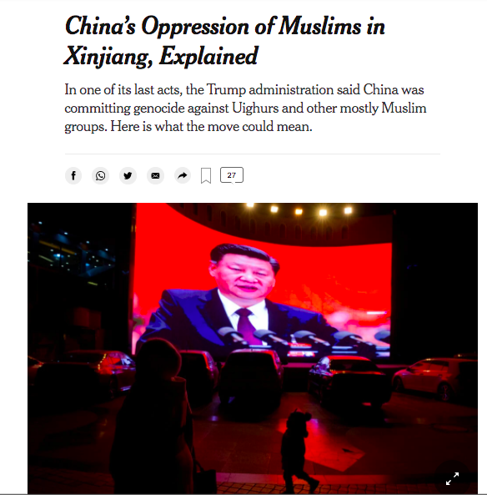
China’s Oppression of Muslims in Xinjiang, Explained
https://www.nytimes.com/2021/01/20/world/asia/china-genocide-uighurs-explained.html?searchResultPosition=4

Slide 3
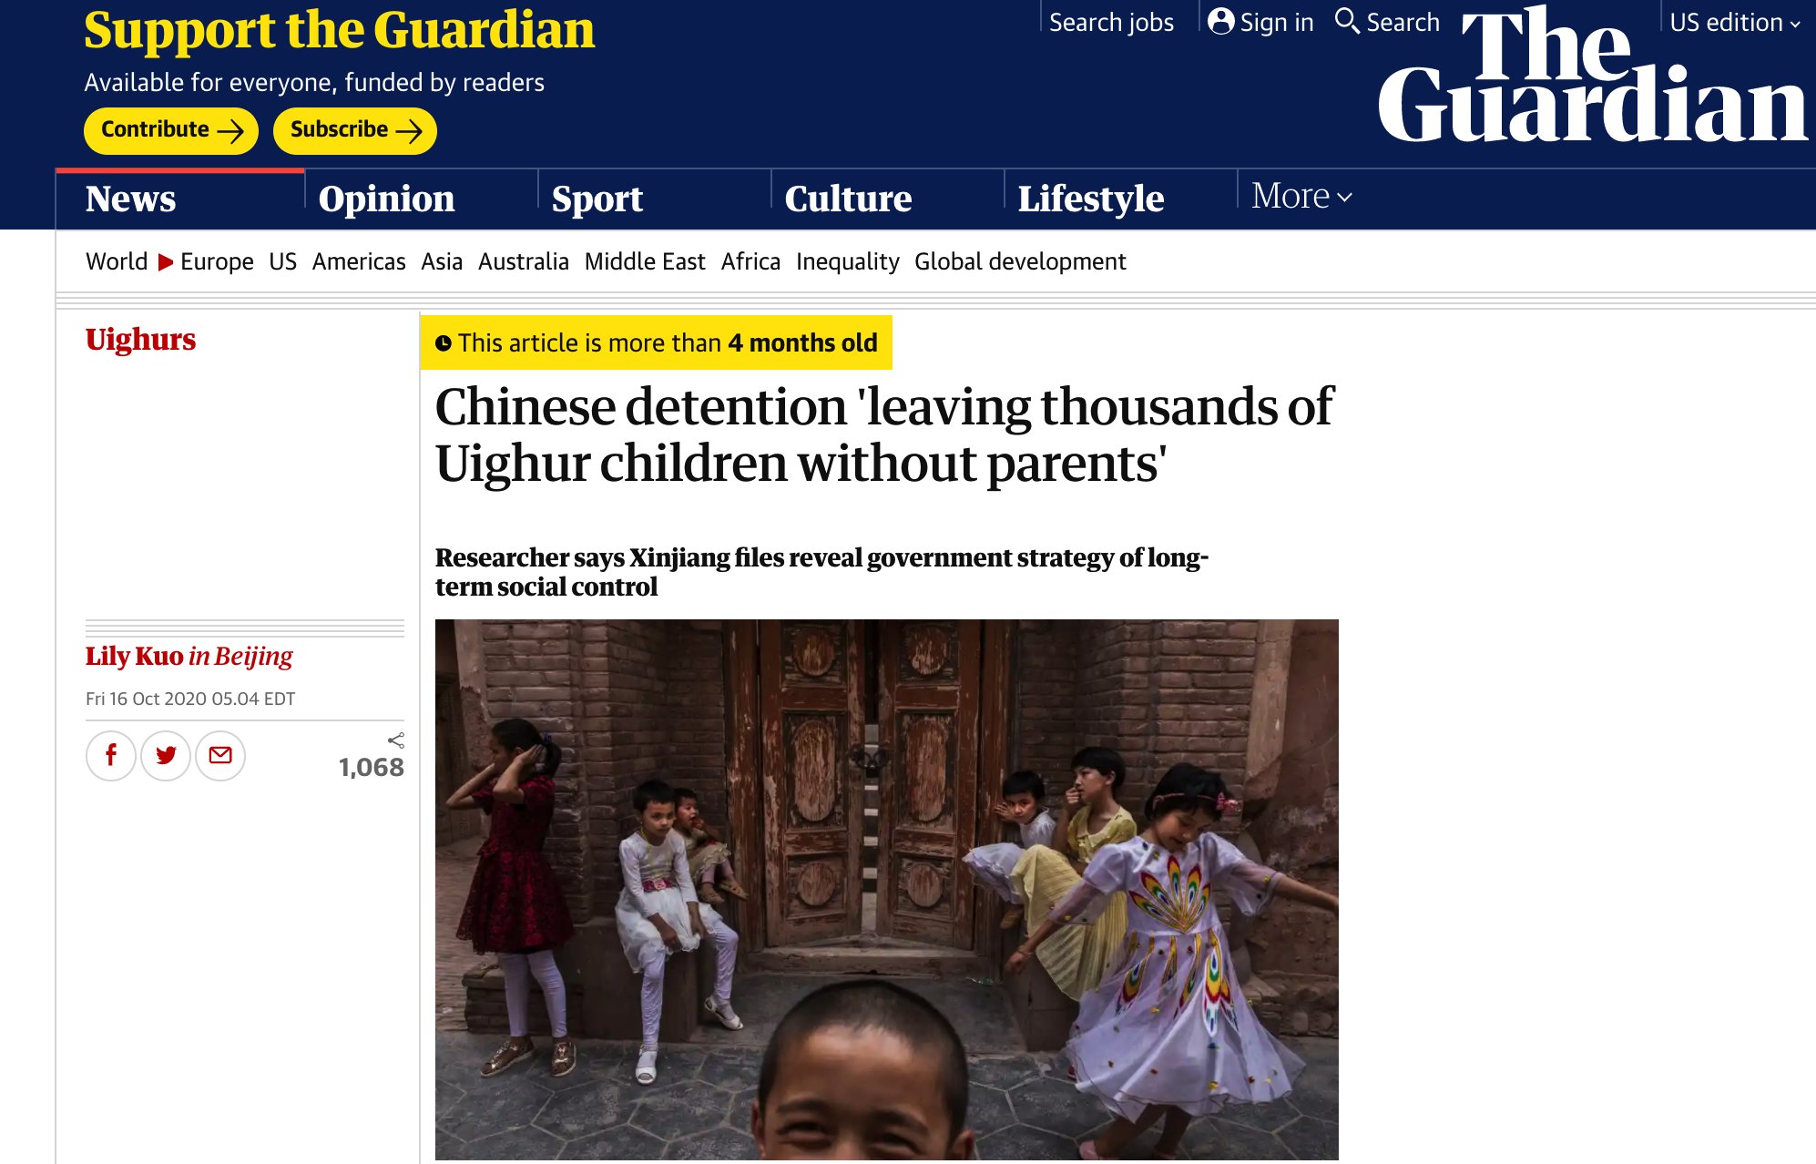
Chinese detention ‘leaving thousands of Uighur children without parents’
https://www.theguardian.com/world/2020/oct/16/thousands-of-uighur-children-orphaned-by-chinese-detention-papers-show

Slide 4
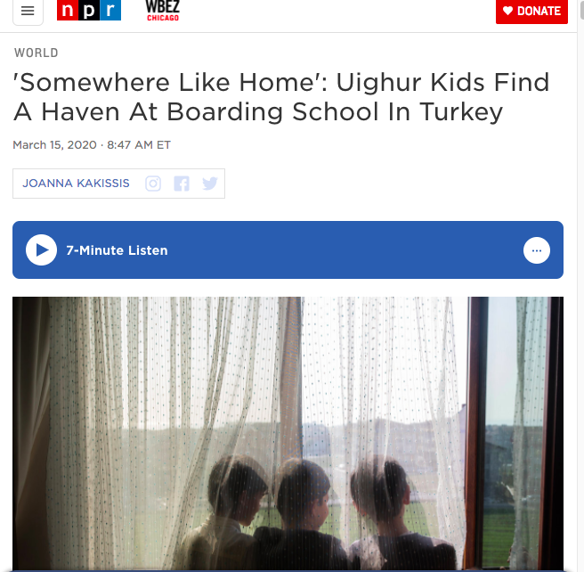
'Somewhere Like Home': Uighur Kids Find A Haven At Boarding School In Turkey
https://www.npr.org/2020/03/15/798662027/somewhere-like-home-uighur-kids-find-a-haven-at-boarding-school-in-turkey

Slide 5
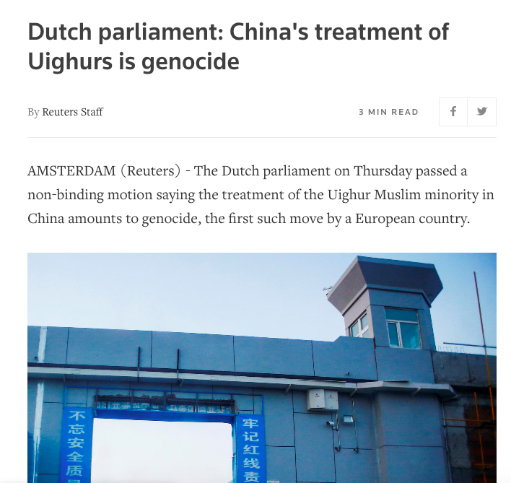
'Somewhere Like Home': Uighur Kids Find A Haven At Boarding School In Turkey
https://www.reuters.com/article/us-netherlands-china-uighurs-idUSKBN2AP2CI

Slide 6
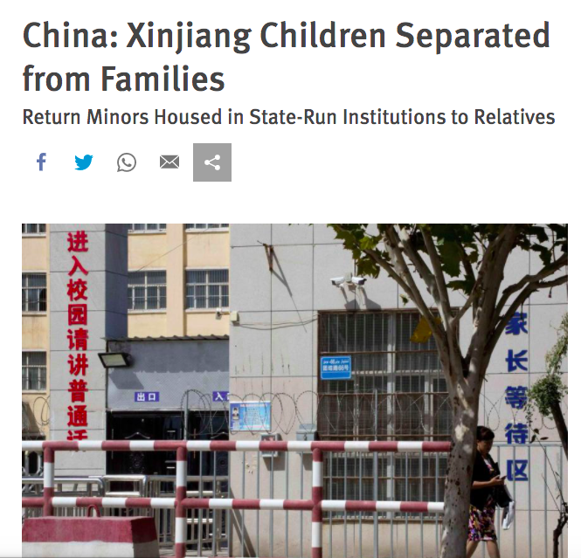
China: Xinjiang Children Separated from Families
https://www.hrw.org/news/2019/09/15/china-xinjiang-children-separated-families

